Slide 1


Bray, D. and H. von Storch, 1999: Climate Science. An empirical example of postnormal science. Bull. Amer. Met. Soc. 80: 439-456
Stehr, N., and H. von Storch, 1999: An anatomy of climate determinism. In: H. Kaupen-Haas (Ed.): Wissenschaftlicher Rassismus - Analysen einer Kontinuität in den Human- und Naturwissenschaften. Campus-Verlag Frankfurt a.M. - New York (1999), 137-185, ISBN 3-593-36228-7
von Storch, H., 2009: Climate Research and Policy Advice: Scientific and Cultural Constructions of Knowledge. Env. Science Pol. 12, 741-747
von Storch, H., Chen X (陈学恩), B. Pfau-Effinger, D. Bray and A. Ullmann, 2019: Attitudes of young scholars in Qingdao and Hamburg about climate change and climate policy – the role of culture for the explanation of differences. Advances in Climate Change Research, online: 10.1016/j.accre.2019.04.001
Hans von Storch
Climate science as a social process – history, climatic determinism, CUDOS und post-normality
18. November 2020 – Seminar "Perspectives on Climate Sciences: From historical developments to research frontiers”, online

Slide 2
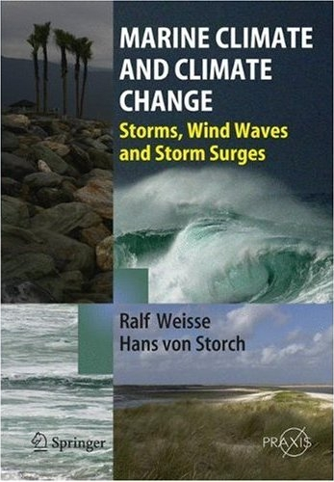
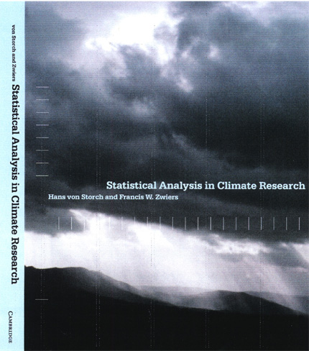
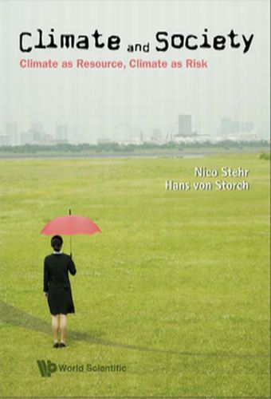

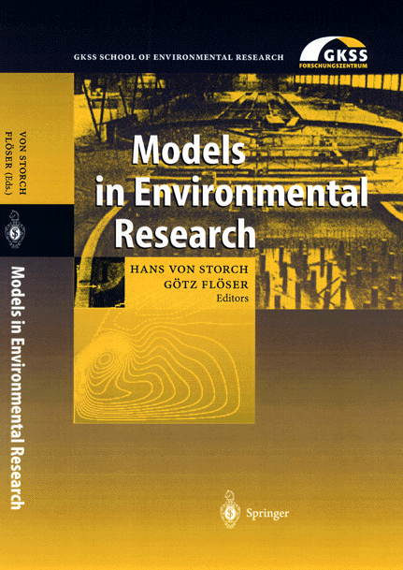
VON STORCH, Hans
Climate researcher (in the field since 1971)
Coastal climate (storms, storm surges, waves; North and Baltic Sea, North Atlantic, Yellow Sea, South China Sea); statistical analysis; numerical experimentation
Director emeritus of the Institute of Coastal Research of the Helmholtz Zentrum Geesthacht, Germany
Professor at Universität Hamburg (MIN and WiSo Faculties)
Guest professor at 中国海洋大学
Lead author of IPCC, AR3 and AR5

Slide 3
Part I: Climate as natural and social object
Since ages, the topic of climate – in the sense of “usual weather” - has attracted attention in the western tradition as a possible explanatory factor. Climate, and its purported impact on society, has become an integrated element in western thinking and perception.
An important issue in the history of western ideas about the climatic impact on humans and society, is the concept of climatic determinism. This ideology favored the perception of the westerners being superior to the people in the rest of the world.
“The term climate, taken in its most general sense, indicates all the changes in the atmosphere, which sensibly affect our organs, as temperature, humidity, variations in the barometrical pressure, the calm state of the air or the action of varying winds, the amount of electric tension, the purity of the atmosphere or its admixture with more or less noxious gaseous exhalations, and, finally, the degree of ordinary transparency and clearness of the sky, which is not only important with respect to the increased radiation from the earth, the organic development of plants, and the ripening of fruits, but also with reference to its influence on the feelings and mental condition of men”.
(A. von Humboldt:, 1845: Cosmos, A Sketch of a Physical Description of the Universe)

Slide 4
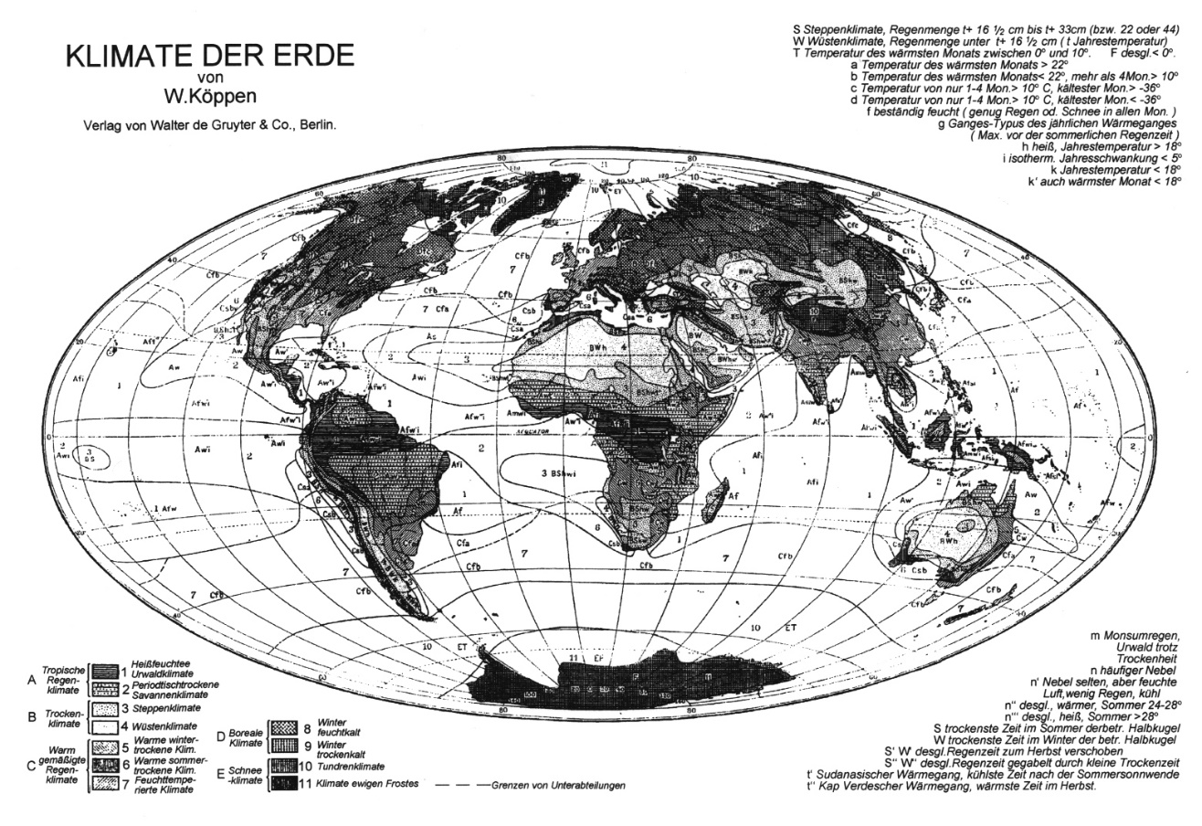
Climate Science, past
Until about the middle of the 2th century, the global climate was determined by studying the climate in all regions of the world, mostly by drawing maps. These regional maps were assembled into global maps, as for instance done by V. Köppen and others. In general, climatology was needed for agriculture but also for transport and trade.
A major application of climatology was planning for colonial acquisitions, and for shipping routes for connecting colonies with homelands.
The question if colonial regions would be suitable for permanent settlement was a key aspect of geographers in Europe.
For instance, in 1938 at the International Congress of Geography in Amsterdam, acclimatization (of “white” people) almost all contributions to “colonial geography” ) was dealt with by almost all contributions to “colonial geography”– with a focus on barriers for European (“white race”) settlement.

Slide 5
Climatic Determinism
Stehr, N., and H. von Storch, An anatomy of climate determinism. In: H. Kaupen-Haas (Ed.): Wissenschaftlicher Rassismus - Analysen einer Kontinuität in den Human- und Naturwissenschaften. Campus-Verlag Frankfurt a.M. - New York (1999), 137-185, ISBN 3-593-36228-7, 1999
In 1910, Fritz Jaeger was the first geographer, who was bestowed a chair of “colonial geography” in Germany. He argued that the physical properties of the landscape and of the people would be related to climate. Using the standard stereotype of a warm-wet climate, which would reduce the amount of work needed for a living, he claimed that in such countries people would have remained on a lower level of culture. Very different would be “raw” climate of mid latitudes, which would force people to hard work and build higher culture. Thus, it is climate, which causes the difference between tropical people and Europeans – so that the colonization was legitimate because of the cultural superiority of the Europeans. This is the old and powerful narrative of climatic determinism:
“Climatic determinism is the understanding that knowledge about the state of the climate, be it stationary or changing, provides significant insight about socially relevant processes, such as economic efficiency, physical energy and health of people or social and civilizational aspects and achievements. In the classical climatic determinism, the success of certain people in attaining ‘high levels of civilization’ was attributed mostly to climate“ (Stehr and von Storch, 1999).
Stehr and von Storch prepared an inventory of the purported impacts of climate – they range from alcoholism, crime, cleanliness, mortality, life expectancy, fertility, temperament, and stupidity to work attitudes, to mention some.

Slide 6
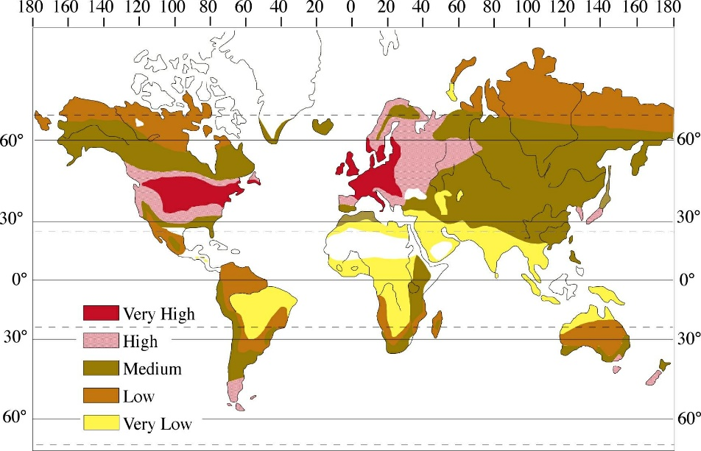
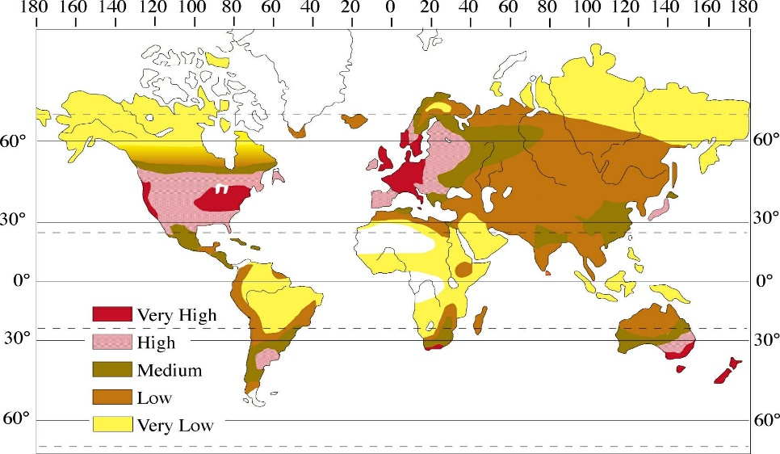
Ellsworth Huntington
The most known “modern” representative of climatic determinism was Ellsworth Huntington who drew the significant conclusion: "Thus, if all other influences were eliminated, we should expect civilization to advance most rapidly in climates which have few or no months with temperatures above the optimum and many below, but none too far below the optimum. As a matter of fact, the actual distribution of civilization approaches this pattern but departs from it in some respect because mean temperature is only one of the climatic factors of environment, and the effects of physical environment are modified by cultural environment.”
This purported coincidence of “climatic energy” and “level of civilization” was based on two global maps, which shared some similarities. Thus, it was claimed, that there was a difference between favored people, mostly in Europe and some European settlements at mid-latitudes (USA, Australia), and less favored people mostly in the tropics. It as speculated that this difference in living conditions and challenges would not only manifest in economy, and civilization – but also in bodily characteristics, such as the form of noses.
Two key diagrams in Huntington’s analysis. Top: the global distribution of peoples’ energy as derived from climatic conditions; bottom: global distribution of level of civilization as derived from a survey among international experts for the early part of the 20th century.

Slide 7
Climate: us and others
Thus, climate allowed the discrimination between “us” and the “others”, when seen with European eyes. The “others” were unable to develop reasonable levels of civilization, and would not be able to exploit the potentials of their lands and resources. Obviously, they were also unable to withstand the military power of the European powers, which was based on technological advancements.
Climate was considered a major, if not the dominant cause for European “superiority” and the “others’” inferiority, which was a property of the people, and their races, which had formed consistently in the different climates.
Such theories formed a basis for colonial activity, since the local population would be unable to develop efficient governance, economy and finer culture because of the natural barrier of adverse regional climates. This may have led to two conclusions, namely that the advanced Europeans may use the resources of the “others”, as they were incapable of using them for themselves, and that the retarded “others” may need special support and treatment for mitigating the adverse effects of a non-inspiring and non-challenging climate. The former served as a legitimization for colonialism, whereas the other explanation may have been a motivation for widespread evangelization, which often enough seem to have been a pre-form of colonization.

Slide 8
Part II – climate as physical science challenge
In modern time,
natural sciences instituted self-critical processes (repeatability, falsification) and norms (CUDOS @Merton), and
the traditional host for climate issues, namely geography, lost its grip, and physics took over.
This led to a more systematic, critical and rigorous approach of building and testing hypotheses and concepts n the functioning of the climate system.

Slide 9
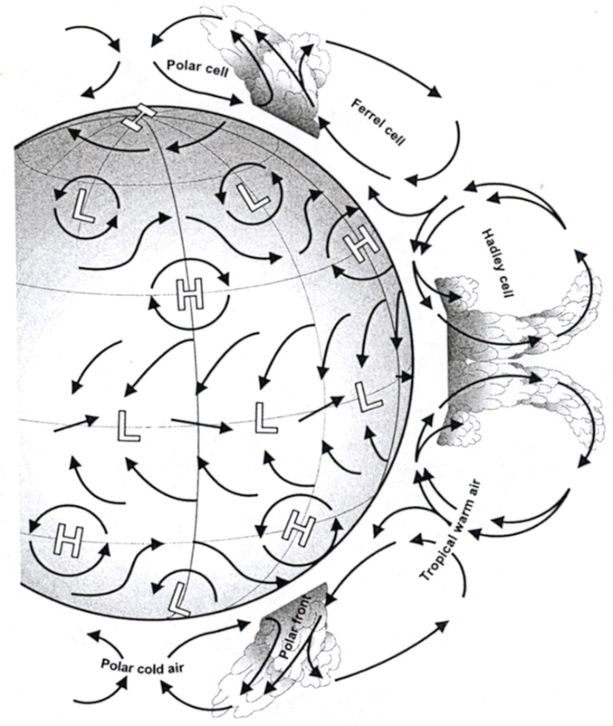
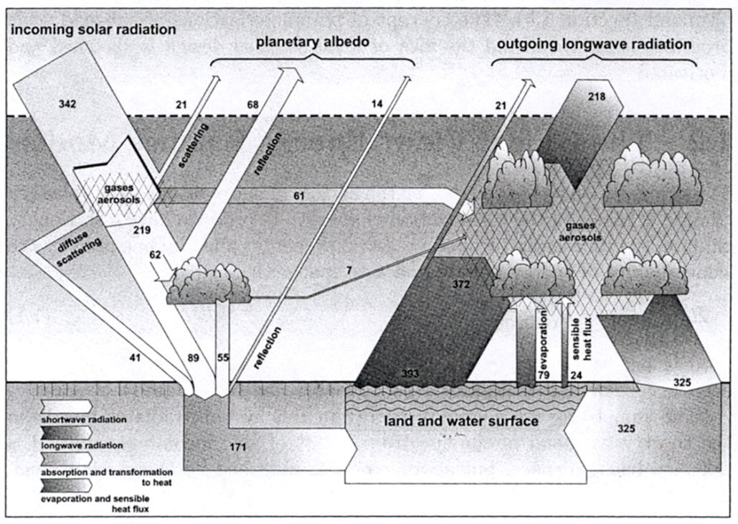
Climate Science, today
The concept of climate has undergone significant changes in the past 100 years.
Since about the 1970s, climate is conceptualized as a global object, which is determined chiefly by the amount of solar radiation arriving at Earth, the rotation of the Earth, and the radiative properties of the atmosphere and of the Earth surface. Regional climate are in this concept the regional manifestations of the global climate, which in principle may be considered the results of “downscaling”. Thus, regional climates are interesting chiefly because of the impacts of climate on georisks, ecosystems, economy and health.
The regional manifestation is a key aspect in dealing with adaptation to man-made climate change, while most of the political debate focusses on the mitigation of global climate change (global warming, tropical storms, sea ice, sea level).

Slide 10
Robert K. Merton‘s CUDOS (1942) Norms for the basic natural scientists
Communalism: the common ownership of scientific discoveries, according to which scientists give up intellectual property rights in exchange for recognition and esteem.
Universalism: according to which knowledge claims are evaluated in terms of universal or impersonal criteria, and not on the basis of race, class, gender, religion, or nationality.
Disinterestedness: scientists, when presenting their work publicly, should do so without any prejudice or personal values and do so in an impersonal manner.
Organized skepticism: all ideas must be tested and are subject to rigorous, structured community (peer review) scrutiny.

Slide 11
Natural scientists consider statements as scientific …
when they have been derived by employing a scientific method - have „survived“ falsification, - have out-competed alternative explanations - can be reproduced by independent researchers
when it is made clear that the statements do not represent “truth” but explanations, which for the time being are consistent with observations and theories considered valid, and better than other alternative explanations. At a later time, a re-consideration may be needed if new data and theories lead to contradictions or make better fitting explanations possible.
But not when formulated by scientifically educated people, who do not employ the scientific method (for instance, do no consider alternative explanations, or opt for an explanation because of consistency with a specific school of research).

Slide 12
Truth and CUDOS
When scientists speak to the public, then scientific statements are expected to present “truth”. Scientists enjoy authority based on their “objectivity”.
Society presumes that something like Merton‘s norms (CUDOS) are employed. This is so only to a limited extent (Bray-surveys)

Slide 13
Part III – Climate still a social issue
This gain in methodical rigor went along with the loss of understanding that climate is a less important driver for societal development (“civilization”, “cultures”) and differences than societal processes.
Consequently, the large segments of the climate science field tacitly and unknowingly adopts the false concept of climatic determinism.
Climate science find itself in a “post-normal” condition, which lead to a frequent dominance of political utility over methodical rigor.

Slide 14
The dual face of “climate” – natural world
The word “construction” does not imply arbitrariness. Instead is is alluding to the process of building knowledge by exploiting past explanations, new data , and peer review.
There are scientific, and social constructions .
On the one hand, climate is a concept of natural sciences, which works with the statistics of weather (in atmosphere and ocean). These statistics are named “climate”. The many components of the climate system interact with each other in complex ways. The almost infinite number of potentially chaotic components makes the climate system to a stochastic system.
As such it is an exciting research field for physical scientists, who succeed in understanding the natural world. This understanding is a scientific construction.
In the past decades, we have learned that human activities are changing climate on time scales of tens and hundreds of years.

Slide 15
The dual face of “climate” – social world
On the other hand, climate is impacting societies and ecosystems.
Besides the “real impacts”, there are the social perceptions and social constructions.
These constructions describe a strong vulnerability of societies' and ecosystems to changing climatic conditions
This leads to competing constructions, which inform society and the political decision processes.

Slide 16
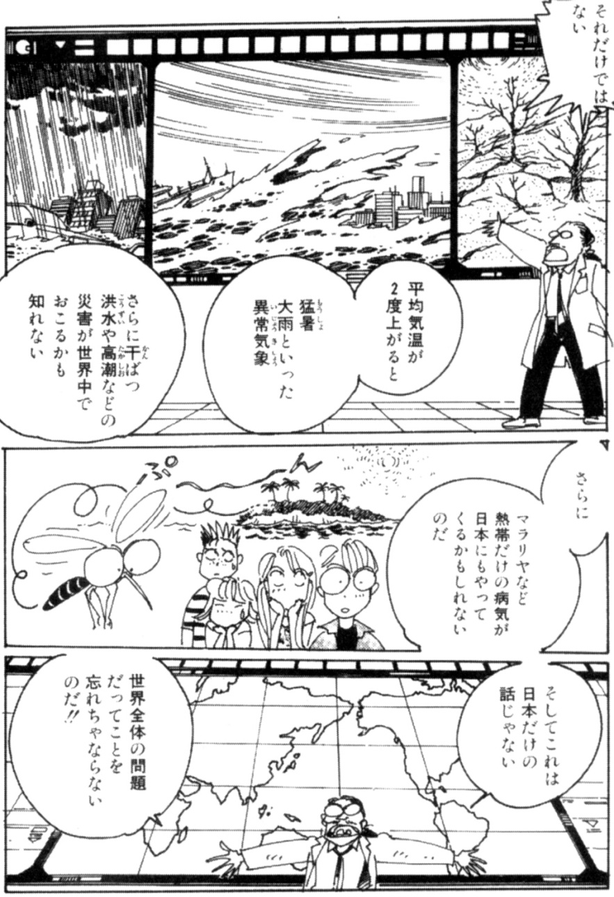
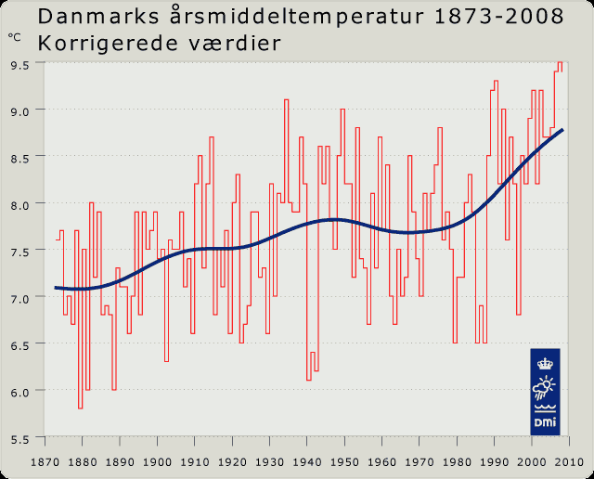
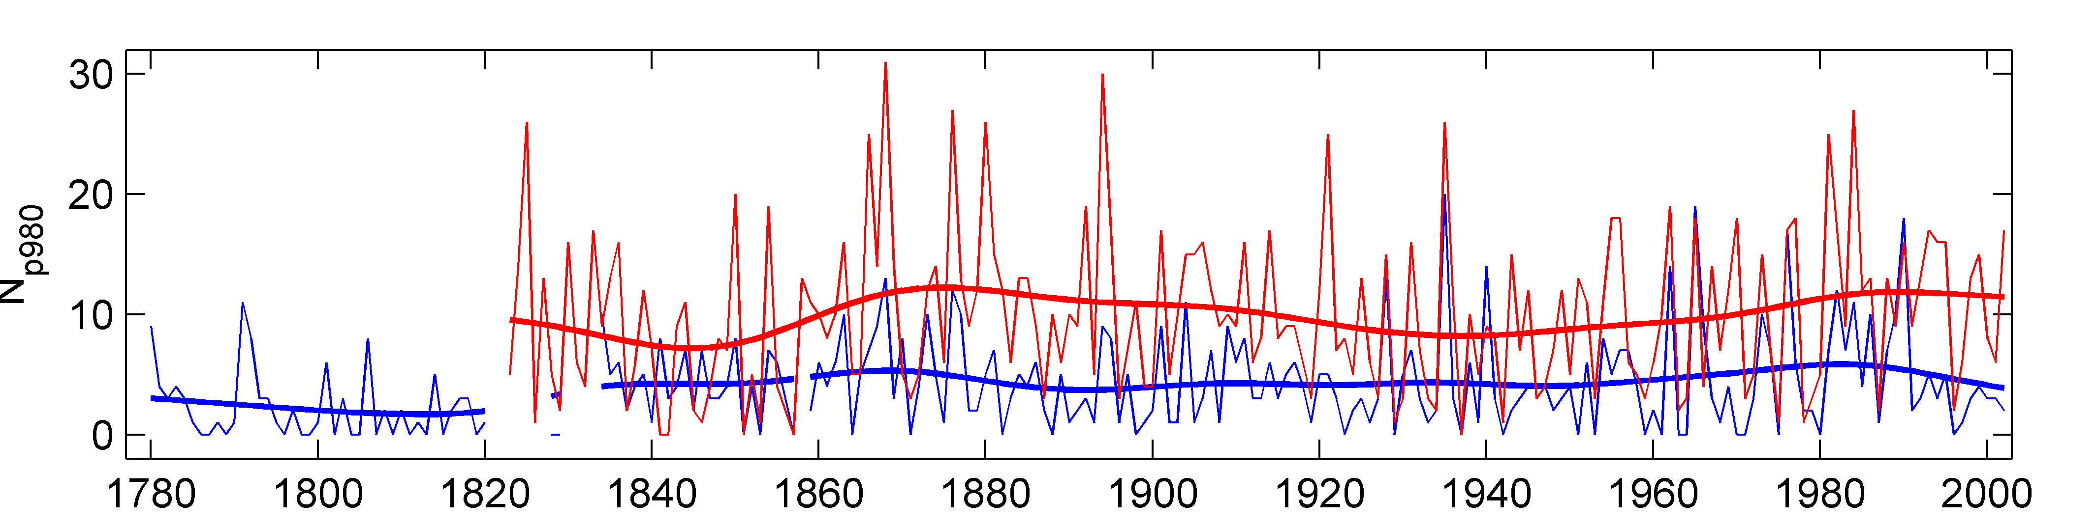
Two different construction of „climate change“ – scientific and cultural – which is more powerful?
Cultural: „Klimakatastrophe“
Scientific: man-made change is real, can be mitigated to some extent but not completely avoided. Some Adaptation is needd
Lund and Stockholm
Storms
Notes:
16

Slide 17
Knowledge market
The science-policy/public interaction is not an issue of „knowledge speaks to power“.
The problem is not that the public is stupid or uneducated. The idea of the “gap model”, according to which people simply do not understand the problem, but will draw the right conclusions when taught accordingly, is false.
The problem is that the scientific knowledge is confronted on the „explanation marked“ with other forms of knowledge (pre-scientific, outdated; traditional, morphed by different interests). Scientific knowledge does not necessarily “win” this competition.
The social process „science“ is influenced by these other knowledge forms.
Science can not be objective but should nevertheless strive to be so.
Notes:
17

Slide 18
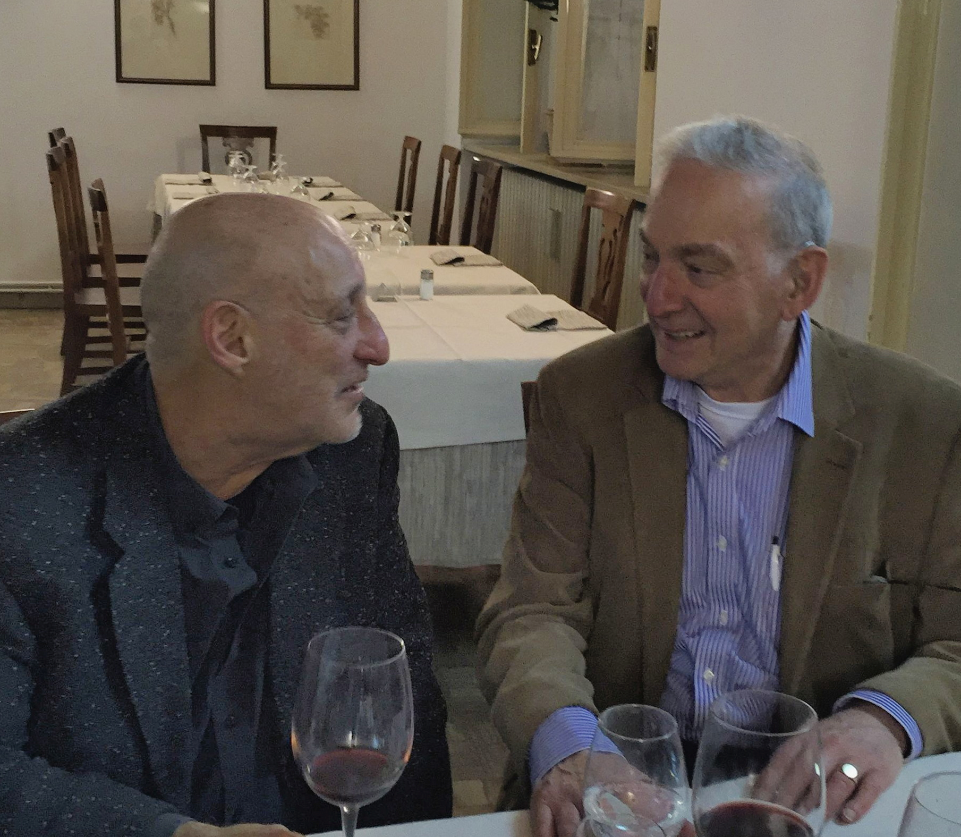
Postnormal science
Jerry Ravetz, Silvio Funtowicz, 1986 and earlier
State of science, when facts uncertain, values in dispute, stakes high and decisions urgent.
In this state, science is not only done for reasons for curiosity but is asked for as support for preconceived value-based agendas.
Climate Science is in a post-normal phase (Bray and von Storch, 1999)
facts uncertain: e.g. sensitivity of global mean temperature to doubling of CO2 concentration
values in dispute, e.g., do we cement the world according to our present preferences or do we accept a generationally dynamical development?
stakes high, e.g., costs for re-organizing global energy market and future damages
decisions urgent, e.g., to be efficient, re-organization of e.g. traffic must be begun now.
Silvio Funtowicz and Jerry Ravetz

Slide 19
Predictions based on post-normal conditions
Science is „de-scientized“, and „politicized“.
Policy is „de-politicized“, and „scientized“.
Policy decisions are framed as being “without alternative” – scientific knowledge claims are presented as leading to unique „solutions“ which need to be implemented without further democratic influence on the substance.
Some scientists act as policy activists, while exploiting their public authority as scientists.
Emergence of different knowledge claims, among them “alternative facts”.

Slide 20
Climate
scientists …
transgress into policy-prescribing
regularly so,
uniformly (same direction) so.
Trivialize social dynamics, and try to model the world, including the social sphere, as if its dynamics would be governed by a set of deterministic (or stochastic) equations.
Typical pattern of a science in post-normal conditions (high inherent uncertainty; high stake, urgent decisions, values in dispute).

Slide 21
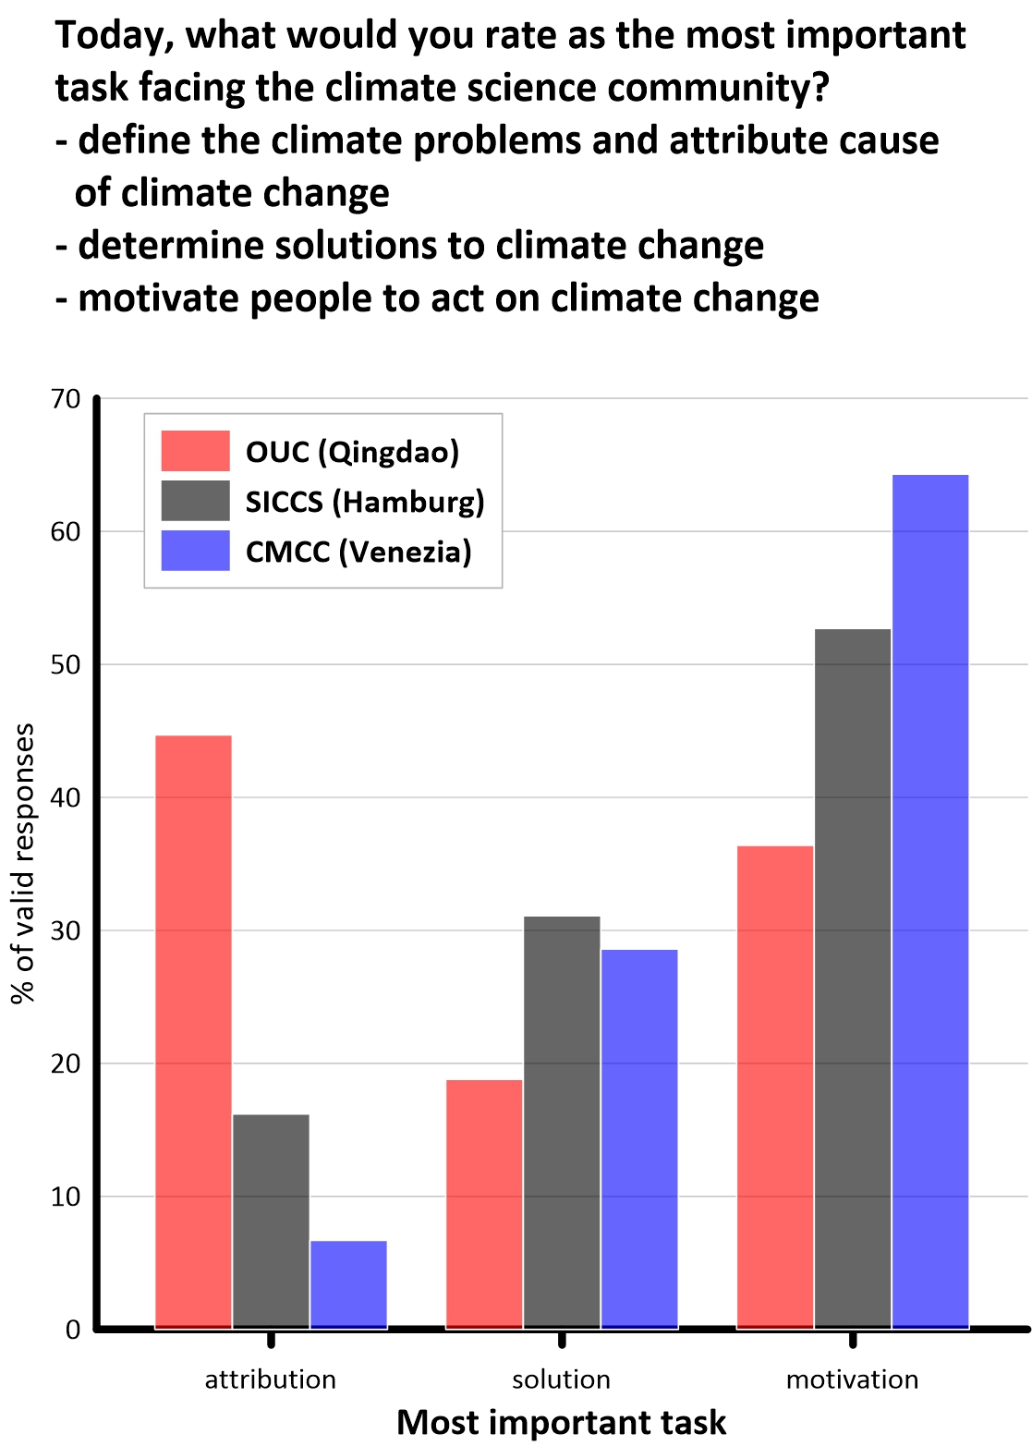
Postnormal conditions have an impact on the functioning of science
Scientific knowledge claims are considered primarily good, when their societal utility is high – not only in a technical sense, but also in terms of reinforcing cultural knowledge claims.
Methodical rigor, openness to alternative explanations become less significant.
Postnormal conditions lead to changes in the scientific organization – programs, perceived leading scientists – which feed back into societies to support a-priori world views (climate catastrophe and fake news).
In climate science, a substantial number of actors consider “motivate people to act on climate change” as main task of the climate science community.

Slide 22
Natural science as a social process
We see that science is under the influence of social constructions and preferences.
… at least when post-normal conditions prevail.
While most try to be “objective”, they can hardly avoid two biases: - in selecting topics considered “significant”, and - weighing the evidence in favor of explanations consistent with their worldview.
… the societal milieu rewards scientific knowledge claims which support dominant social constructions (media, funding, recognition)

Slide 23
Post-normality is significant -
A post-normal situation is not “bad”, but its consequences need recognition:
for the societal utility of science for advising societal decision processes – this utility is strongly diminished because it is not cold, distanced knowledge with diverse but limited (thus incomplete) foci, but camouflaged value-driven agendas.
for the internal functioning of the social process of science – it is less the methodical rigor and openness of the scientist, which is relevant for recognition, acceptance of theories/explanations, and research programs and funding, but consistency with value-driven worldviews, media presence and political weight.
A “cure” could be to openly limit the scientific expertise to its methodically sound core (re-scientizing), and re-establish openly value-based democratic decision process (re-politicizing).

Slide 24
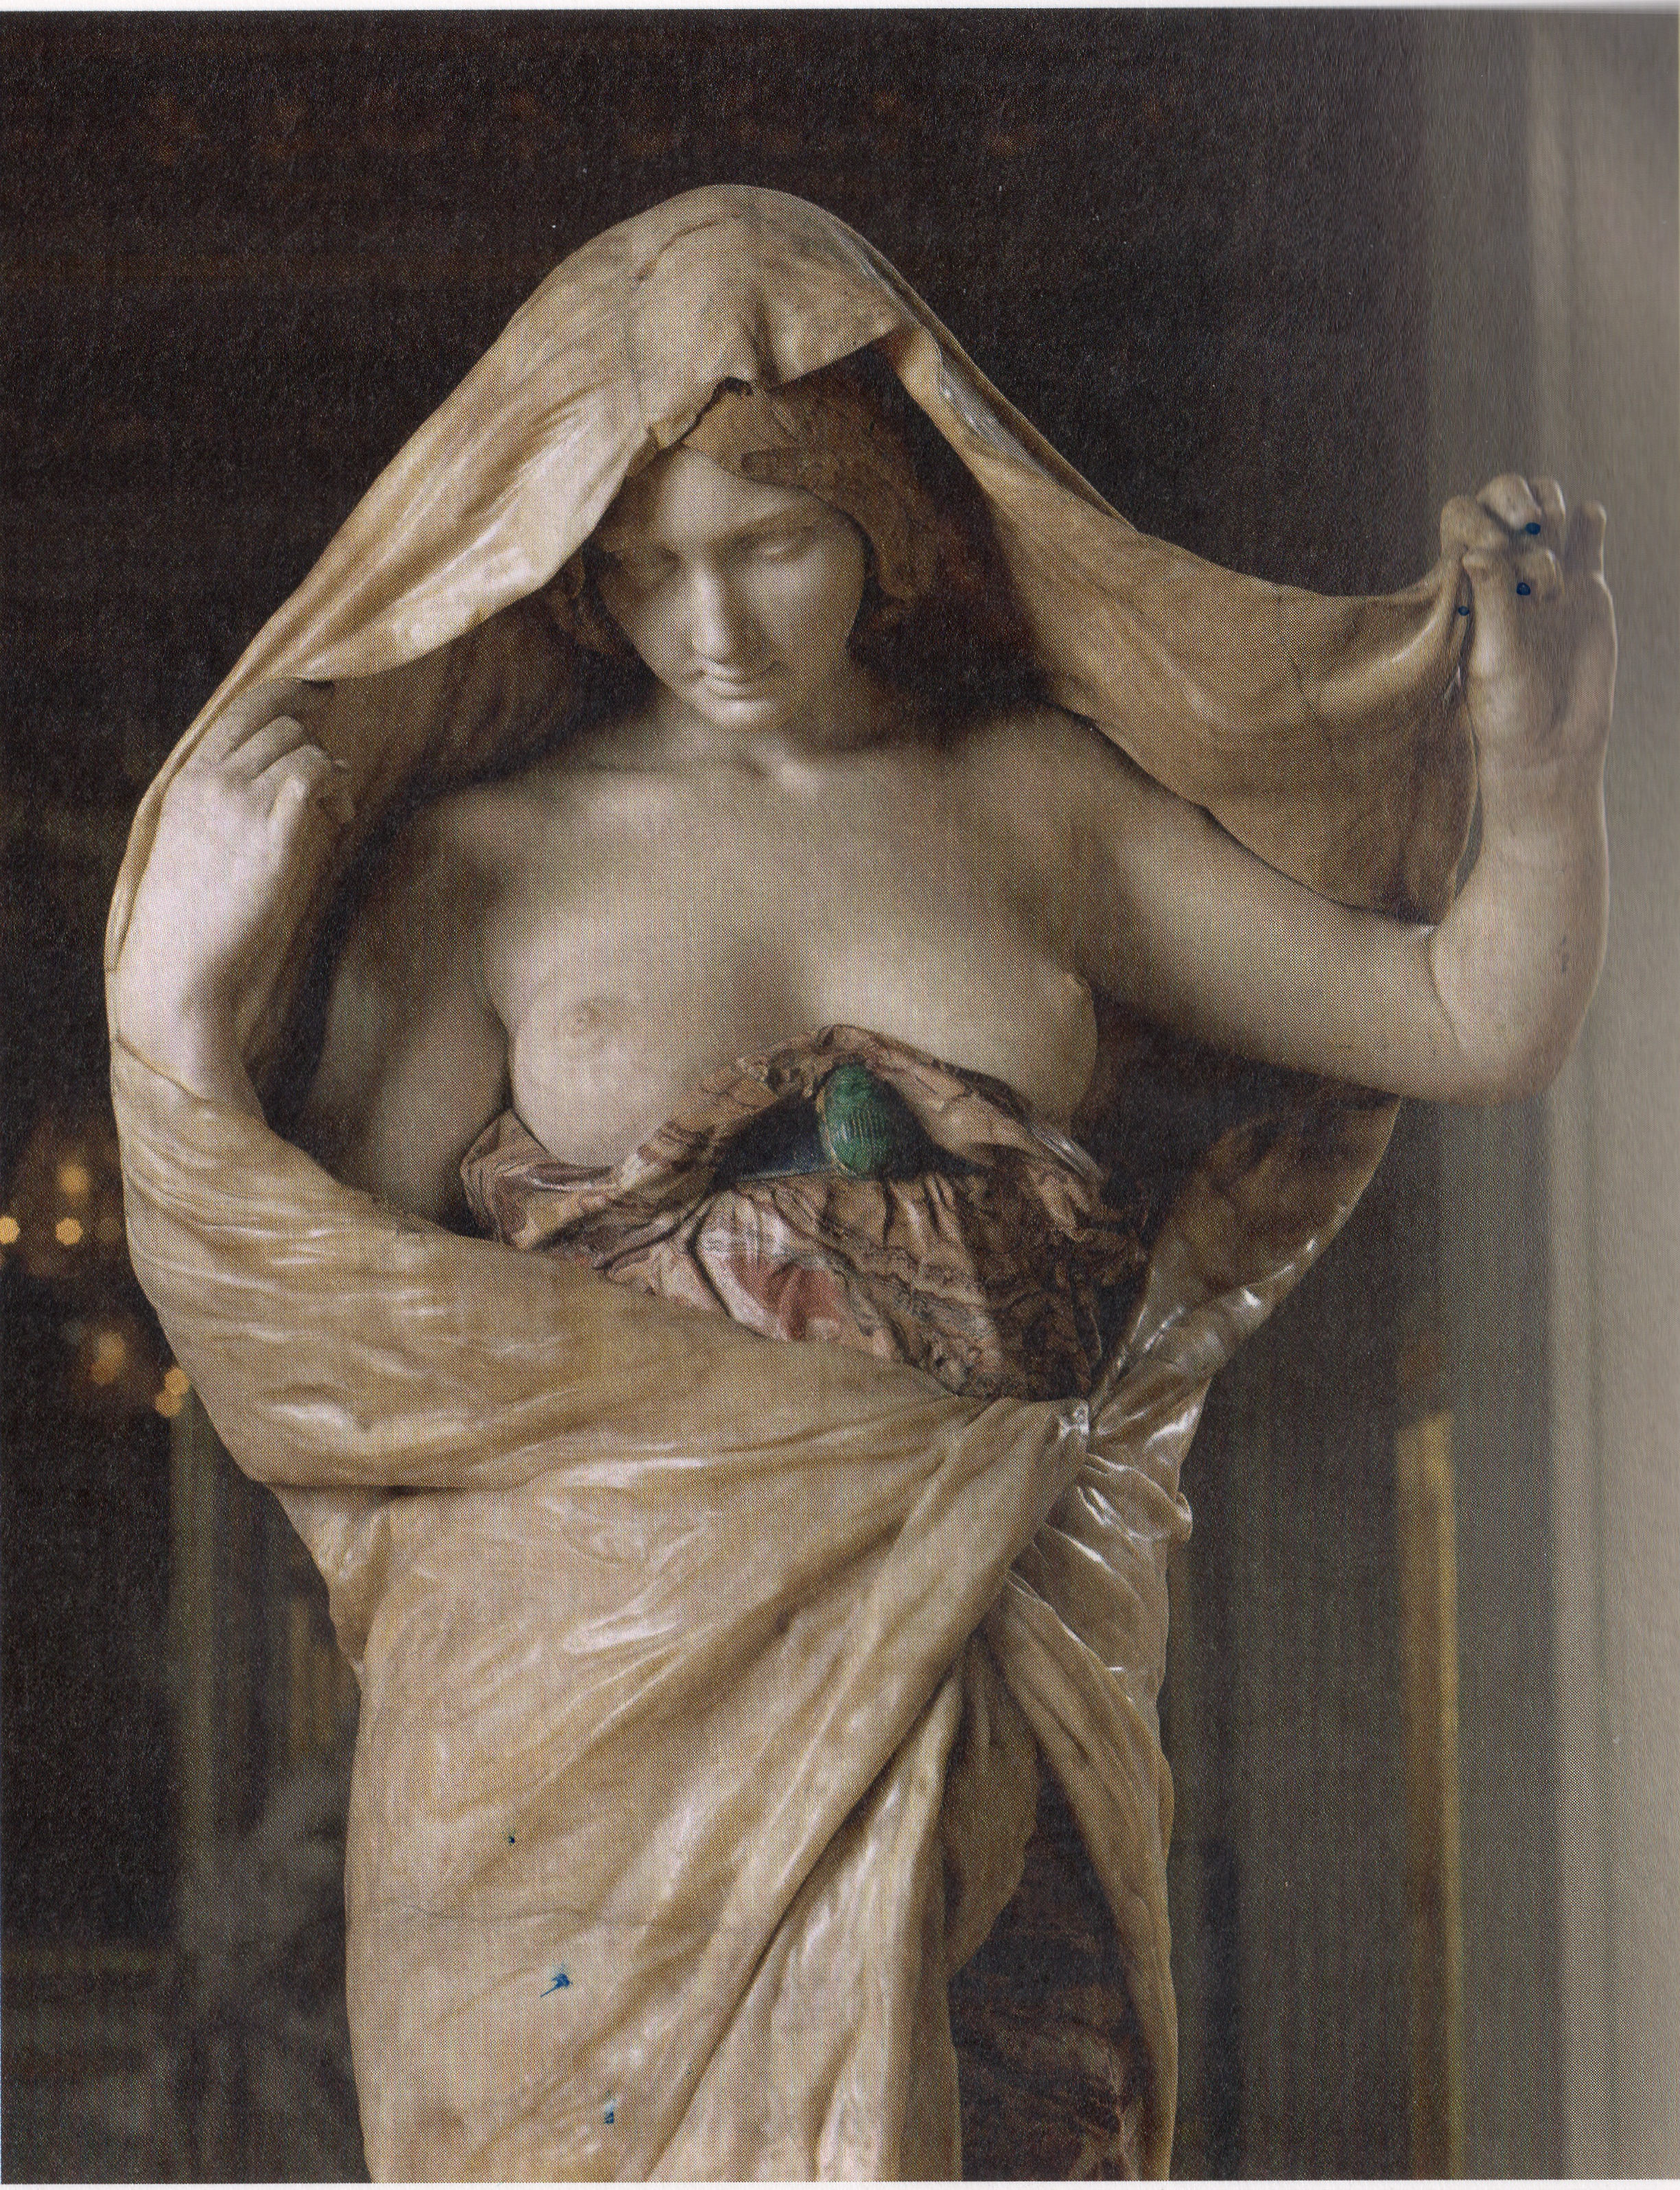
What to do (as a natural scientist)?
Accept post-normal conditions when they prevail.
Accept that science is not unveiling truth (old idea of Arian physics!) but provides best explanations, which are not in contradiction to presently available data and theories. They are considered valid until better explanations have been constructed.
Insist on scientific rigor.
Be open to alternative ideas; try to falsify own conclusions.
Nature reveals herself to science, Paris, Conservatoire National des Arts et des Métier; Luis-Ernest Barrias, 1899; quoted from L. Daston & P. Galison: Objekivität, Suhrkamp

Slide 25
What to do?
When leaving your territory of competence, extend range of cooperation – include social scientists when needed, but try to understand which type of knowledge social sciences build, using which premises. (“Extended peer review”)
When leaving the territory of science, and entering the public / political realm, accept that our knowledge is rather narrow, and provides only a small segment of needed knowledge. (“Campfire”-concept of Krauss and von Storch)
Accept that policymaking is not an optimization problem, but an effort to a balance societal values, and that science strives for best explanations not for (eternal) truth.

Slide 26

hvonstorch@web.de

Slide 27
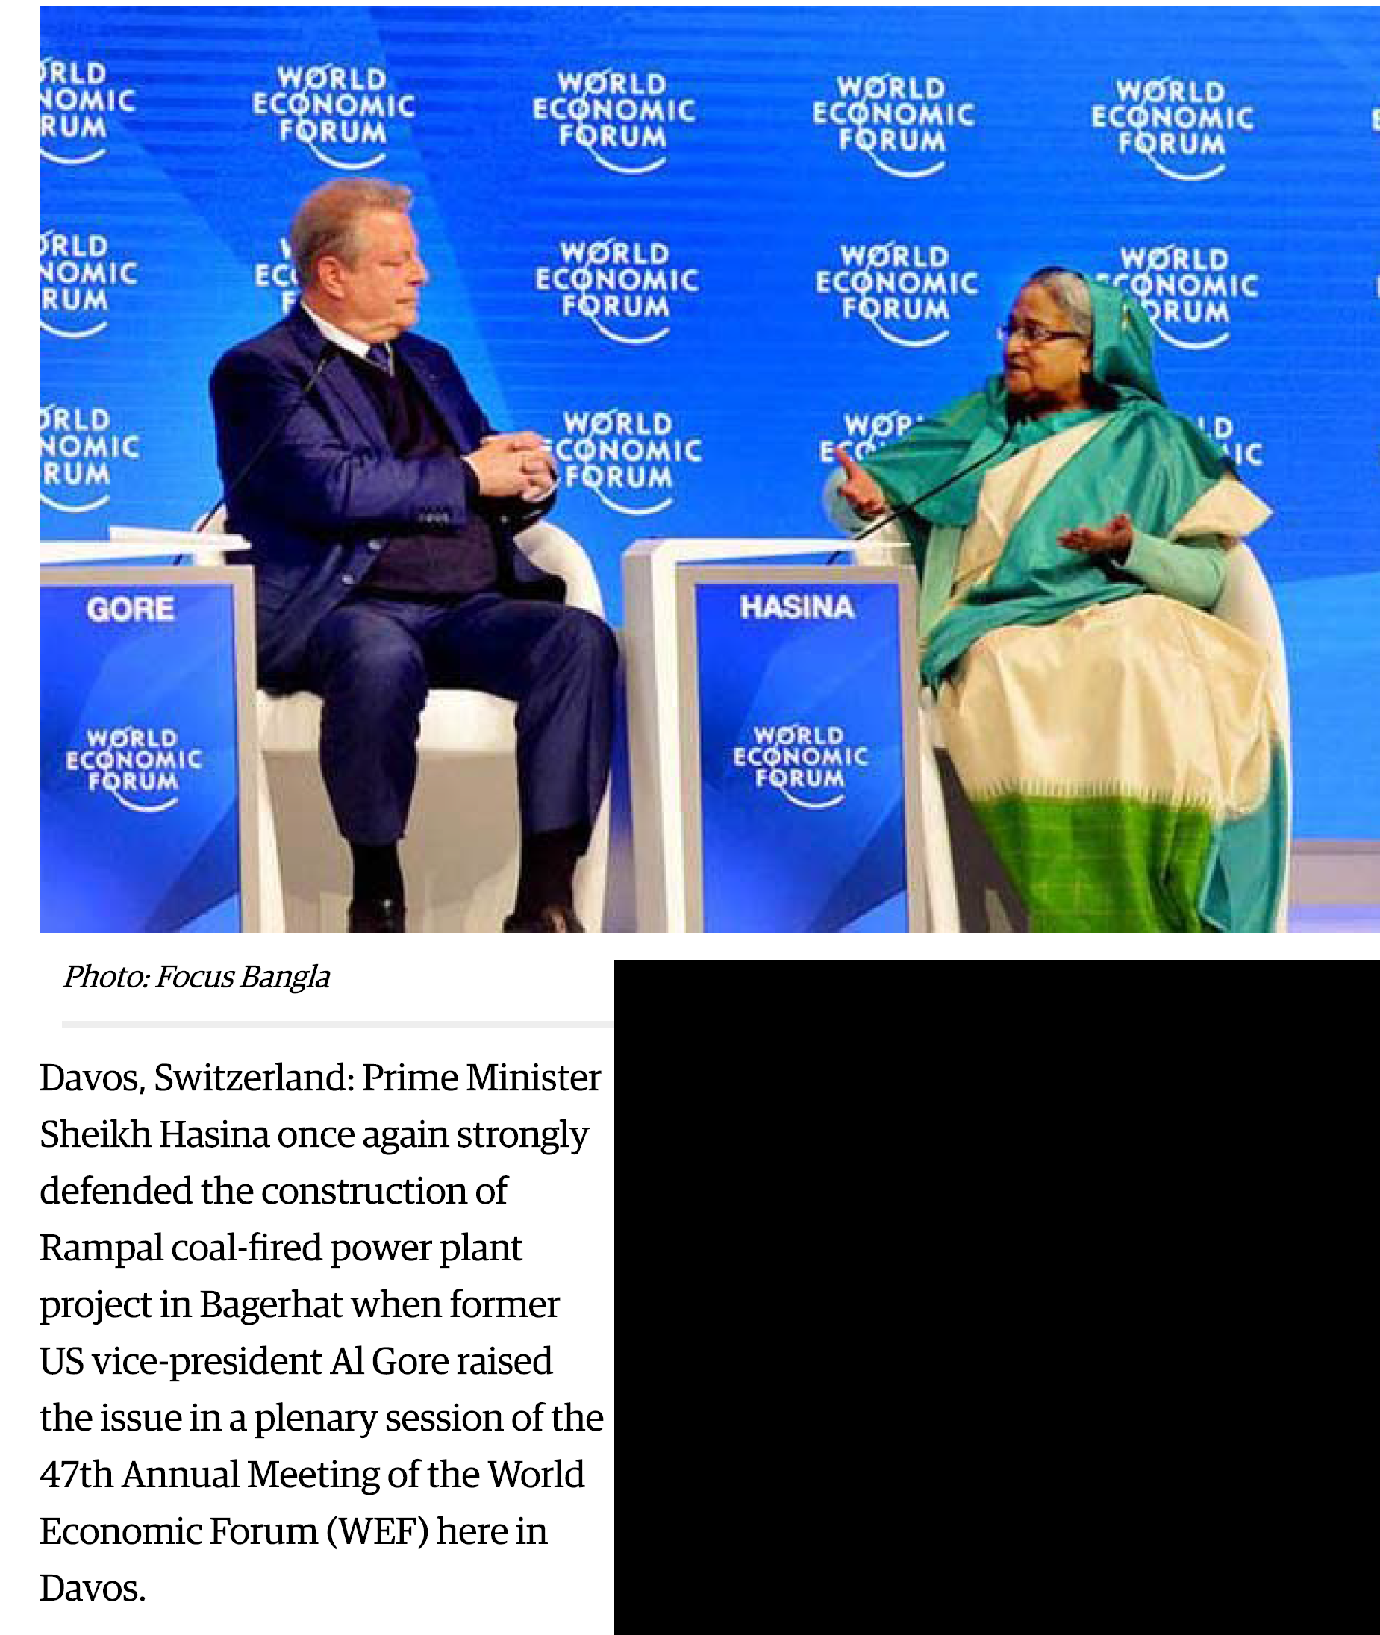
The west knows better …

